Slide 1
Enterprise Java Introduction
BJTU 2020-spring semester

Slide 2
Course Plan
Part 1, The core spring framework for web development
Part 2, Web Services and service integration
Part 3, Reactive spring framework
Part 4, Microservices and cloud

Slide 3
Lecture outline(tentative)
Week 1 | Course Introduction Java Servlet Container
Week 2 | Core Spring Framework Overview Spring MVC
Week 3 | Spring MVC
Week 4 | Spring JPA
Week 5 | Spring Security
Week 6 | Configuration of Spring
Week 7 | Web Services and Restful Soap and Jax-WS
Week 8 | Restful Implementation with Spring & Jax-Rs
Notes:
Key points:
1, weighting of the parts;
2, what will learn in each parts and the outcomes;
3,

Slide 4
Lecture outline(tentative)
Week 9 | Asynchronous Messaging, Kafka
Week 10 | Service Integration architecture
Week 11 | Spring WebFlux
Week 12 | Reactive Restful with Spring
Week 13 | Persisting data reactively with Spring
Week 14 | Microservices with Spring boot
Week 15 | Service Registry with Netflix Eureka
Week 16 | open... tbd...
Notes:
Key points:
1, weighting of the parts;
2, what will learn in each parts and the outcomes;
3,

Slide 5

Teaching Methods
Duration: 16 weeks, 32hours in total
Lectures plus Hands-on Tutorials (During every week’s lecture)

Slide 6
Grading
Grading will be based on the following weighting scheme.
100%: Programming assignments
Distributed Computing - Introduction

Slide 7
Assignments
Assign1: Spring MVC
Assign2: Restful Service
Assign3: Messaging with Kafka
Assign4: Reactive in Spring
Assign5: Service Registration

Slide 8
Project
One group is made up of at most 3 students.
The Project
design and implement server side app with multiple features
Brief document

Slide 9
Textbook & Resources
https://spring.io/docs
Any book on Spring 5
Internet tutorials on Spring 5

Slide 10
Contact
Email: lgzeng@bjtu.edu.cn
discomput_zeng@126.com
Notes:
Sample: https://github.com/FredJul/Flym

Slide 11
Objective
Learning enterprise application development with Java
Programming APIs and Frameworks
Programming models and design patterns
Distributed computing models and architecture

Slide 12
Enterprise Java Overview

Slide 13
History of JavaEE
In the first version of Java, Java enterprise extensions were simply a part of the core JDK.
Then, as part of Java 2 in 1999, these extensions were broken out of the standard binaries, and J2EE, or Java 2 Platform Enterprise Edition, was born. It would keep that name until 2006.
For Java 5 in 2006, J2EE was renamed to Java EE or Java Platform Enterprise Edition.
In September 2017, Oracle decided to give away the rights for Java EE to the Eclipse Foundation (the language is still owned by Oracle), JavaEE is now the Jarkata EE.

Slide 14
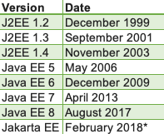
History of JavaEE
https://jakarta.ee/
https://www.oracle.com/technetwork/java/javaee/tech/index.html
Notes:
https://www.oracle.com/technetwork/java/javaee/tech/index.html list the features and apis of Java EE 8

Slide 15
Java EE Specifications
https://www.oracle.com/java/technologies/java-ee-glance.html

Slide 16
Spring Framework
An application framework and inversion of control container for the Java platform
Inversion of control container (dependency injection)
Aspect-oriented programming framework
Data access framework
Transaction management
Model–view–controller framework
Remote access framework

Slide 17
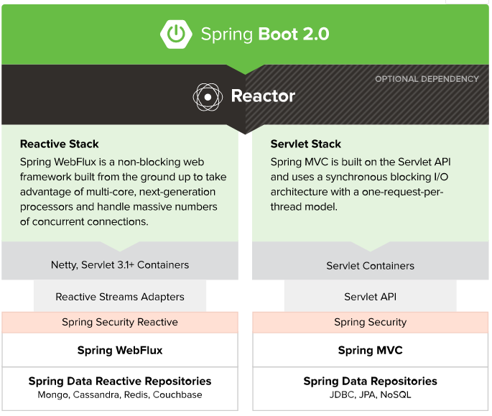
Spring Framework An application framework and inversion of control container for the Java platform.

Slide 18
Spring 5
Spring 5 runs on Java 8, so spring code can leverage lambda expressions to improve code readability.
Spring 5 also supports java 9, so we can create our applications on module based architecture too.
Spring 5 supports Java EE 7 and also compatible with Java EE 8. So we can use Servlet 4.0, Bean Validation 2.0, JPA 2.2 in our applications.
Spring 5 applications preferred server versions are Tomcat 8.5+, Jetty 9.4+ and WildFly 10+.

Slide 19
Spring WebFlux
Spring WebFlux is the new module, it’s an alternative to spring-webmvcmodule and built on reactive framework.
This module is used to create fully asynchronous and non-blocking application built on event-loop execution model.

Slide 20
Spring Boot
-Get started in seconds using Spring Initializr
-Build anything: REST API, WebSocket, web, streaming, tasks, and more
-Simplified security
-Rich support for SQL and NoSQL
-Embedded runtime support: Tomcat, Jetty, and Undertow
-Developer productivity tools such as LiveReload and Auto Restart
-Curated dependencies that just work
-Production-ready features such as tracing, metrics, and health status
-Works in your favorite IDE: Spring Tool Suite, IntelliJ IDEA, and NetBeans

Slide 21
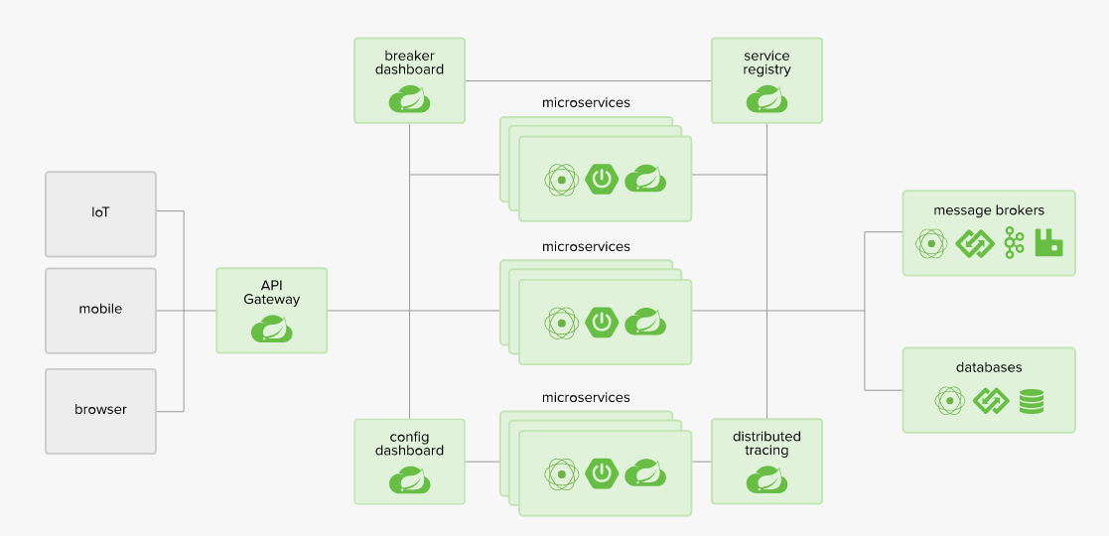
Spring Cloud

Slide 22
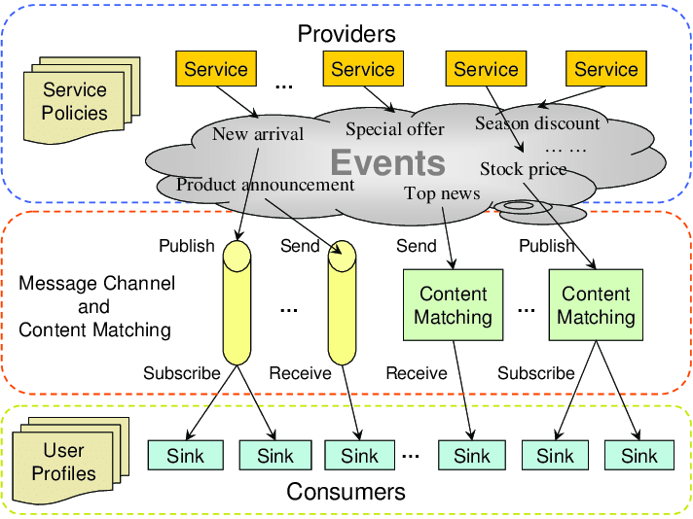
Event Driven Architecture

Slide 23
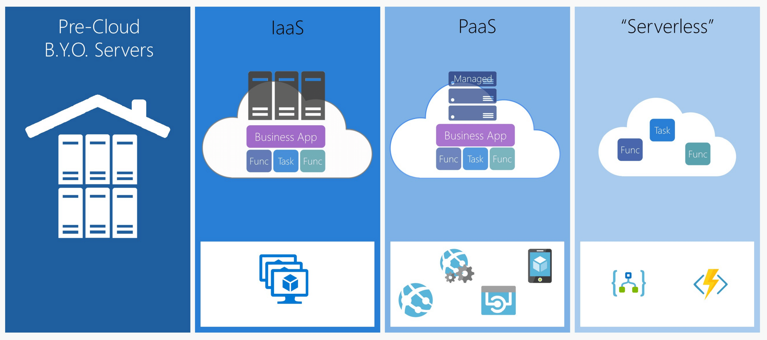
FaaS

Slide 24
More from Spring
Serverless /FaaS
Event Driven
Batch

Slide 25
Reference
https://jakarta.ee/
https://www.oracle.com/java/technologies/java-ee-glance.html
https://spring.io/

